Slide 1


Assiut University Faculty of Computers & Information Computer Science Department
Intelligent Systems
DR.SARA SALAH MOHAMED

Slide 2
Grading
Assessment | Grade %
Final Exam | 50%
Class Work | 15%
Mid-Term Exam | 15%
Project | 20%

Slide 3
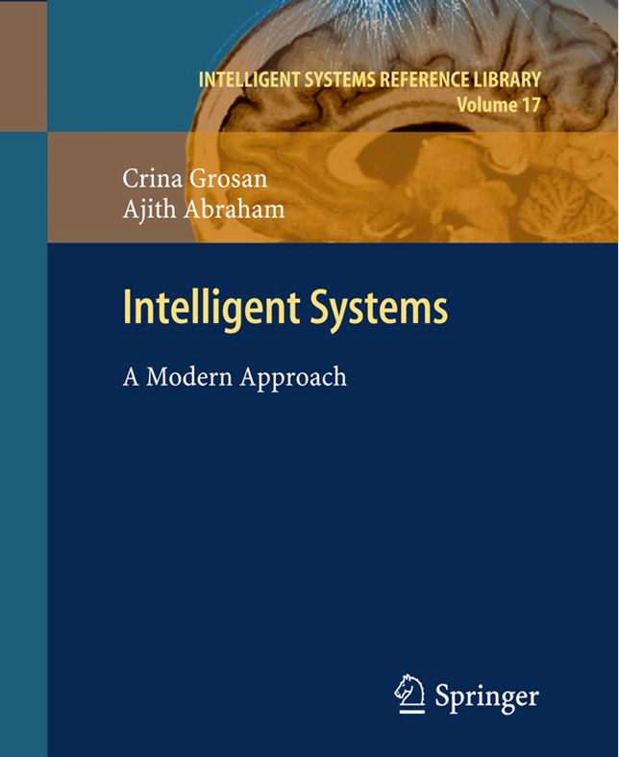
Text Book

Slide 4
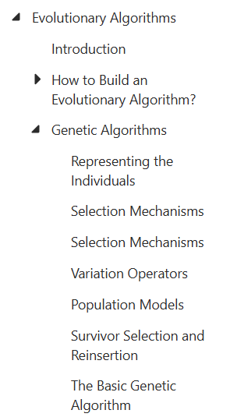
Content

Slide 5
Evolutionary Algorithms
In nature, evolution is mostly determined by natural selection of different individuals competing for resources in the environment. Those individuals that are better are more likely to survive and propagate their genetic material.
The encoding for genetic information (genome) is done in a way that admits reproduction, which results in offspring that are genetically identical to the parent. reproduction allows some exchange and re-ordering of chromosomes, producing offspring that contain a combination of information from each parent. This is the recombination operation, which is often referred to as crossover because of the way strands of chromosomes cross over during the exchange.
The diversity in the population is achieved by mutation operation.

Slide 6
Usually grouped under the term evolutionary computation or evolutionary algorithms:
genetic algorithms
evolution strategies
evolutionary programming
genetic programming .
They all share a common conceptual base of simulating the evolution of individual structures via processes of selection, recombination and mutation reproduction and thereby producing better solutions.

Slide 7
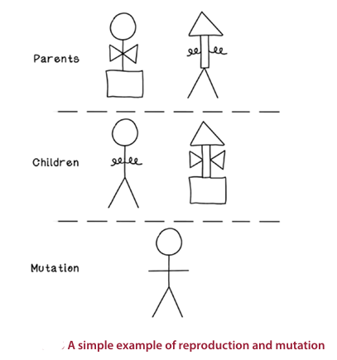
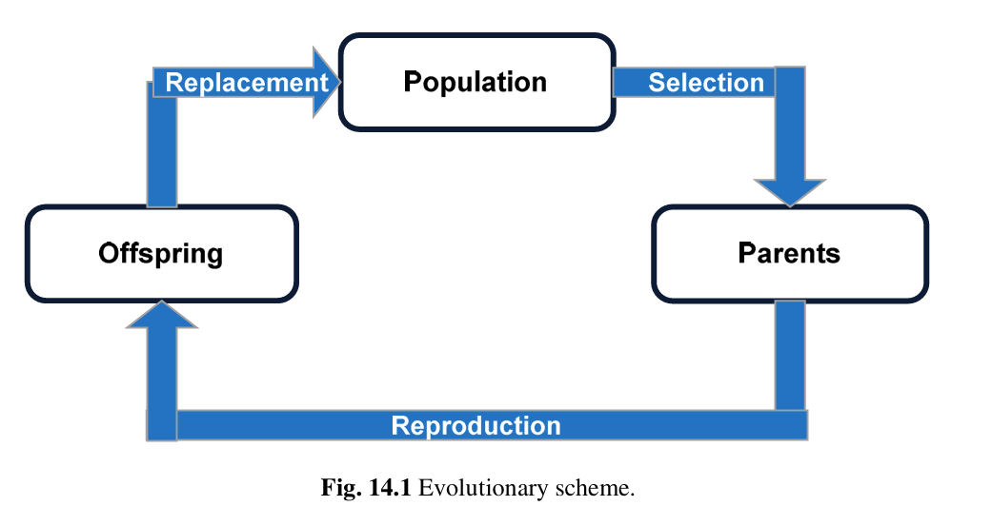

Slide 8
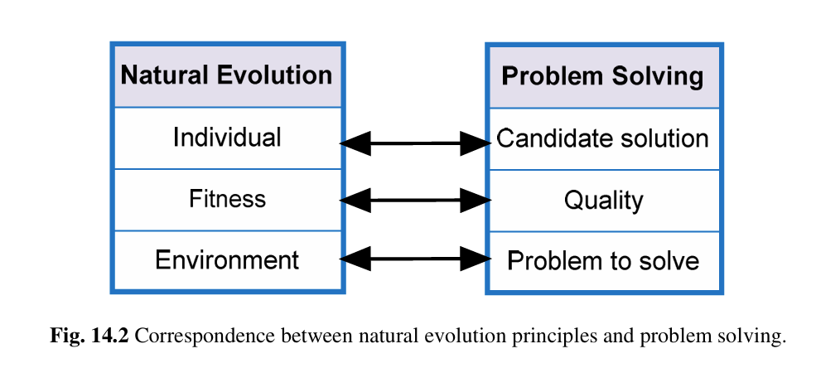
The correspondence between natural evolution and problem solving

Slide 9
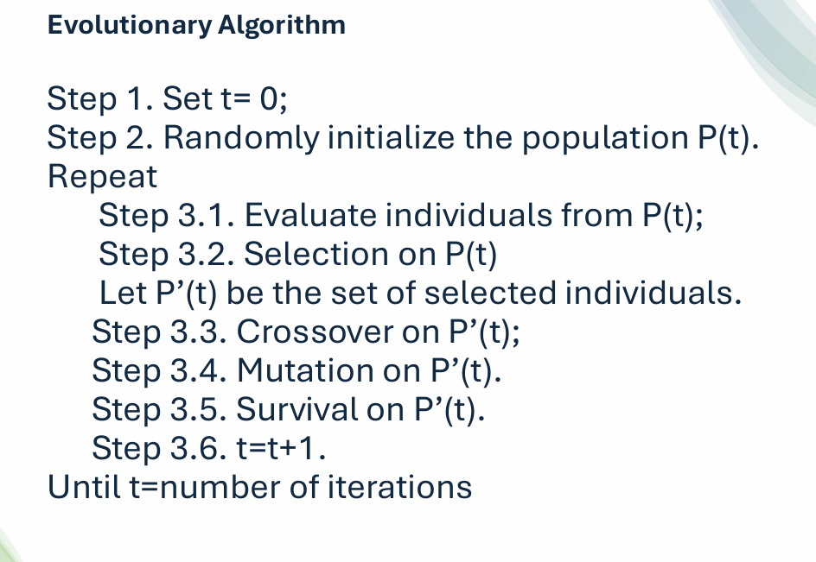

Slide 10
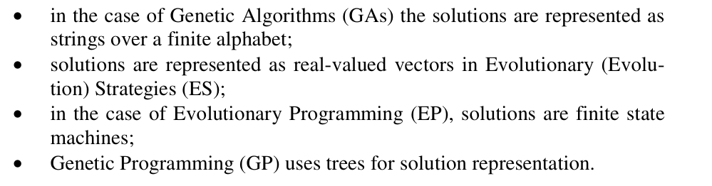
The variants of evolutionary algorithms differ only in technical details

Slide 11
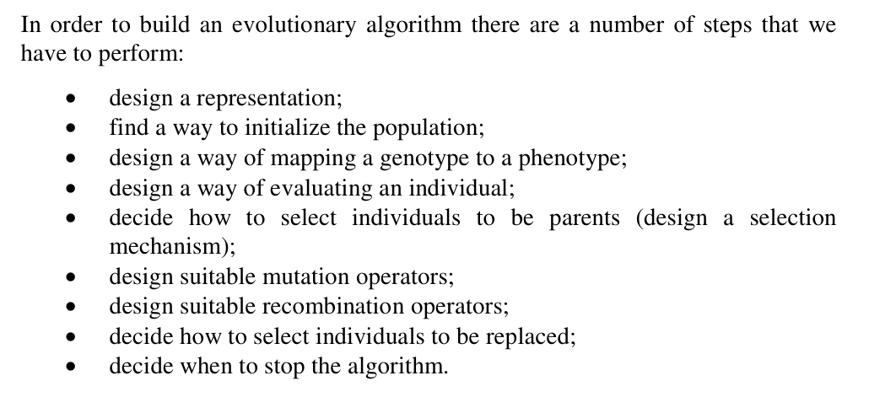
How to Build an Evolutionary Algorithm?

Slide 12
Genetic Algorithms
The most widely known type of evolutionary algorithms and probable the most used are genetic algorithms.
Simple to implement and use
one of the most suitable techniques for any kind of optimization problem

Slide 13
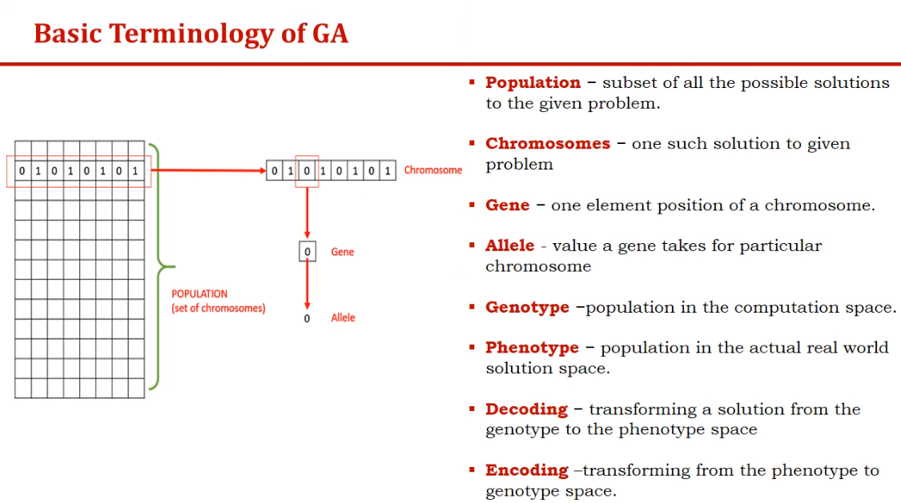

Slide 14
Designing a Representation
Representation here refers to a way of representing an individual as a genotype. An individual is also known as chromosome and it is composed of a set of genes.
Representation of individuals is one of the most important steps in designing a genetic algorithm.
For one problem there can be multiple possible representations; thus, we have to be able to decide which one is more adequate to satisfy our needs and requirements.
The most important types of representing an individual:
• binary representation;
• integer representation;
• real valued or floating- point representation;
• order based or permutation representation.

Slide 15

1-Binary Representation
Binary representation is the most classical and fundamental way to encode solutions in genetic algorithms. Each solution (individual) is represented as a string of bits (0s and 1s).
Why Binary Representation is Popular
Simplicity - Easy to implement and understand
Natural for crossover - Bits can be easily combined
Hardware analogy - Mimics digital computer architecture

Slide 16
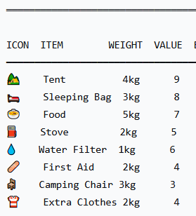
1-Binary Representation
The Knapsack Problem for a Backpacking Trip
[1, 0, 1, 1, 0, 1, 0, 0] means:
- Tent: Yes (1)
- Sleeping Bag: No (0)
- Food: Yes (1)
- Stove: Yes (1)
- Water Filter: No (0)
- First Aid Kit: Yes (1)
- Camping Chair: No (0)
- Extra Clothes: No (0)
Total weight = 4 + 5 + 2 + 2 = 13 kg (within limit ✓)
Total value = 9 + 7 + 5 + 4 = 25

Slide 17
Crossover or Recombination for Binary Representation
During the recombination of binary variables only parts of the individuals are exchanged between the individuals. Depending on the number of parts, the individuals are divided before the exchange of variables (the number of cross points).
1-Single point crossover
2-Double point crossover
3-Uniform crossover

Slide 18
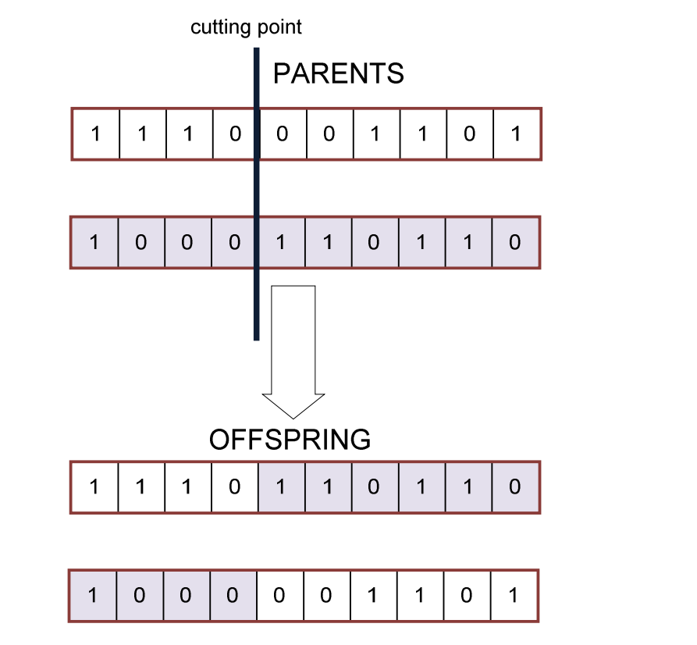
1-Single point crossover

Slide 19
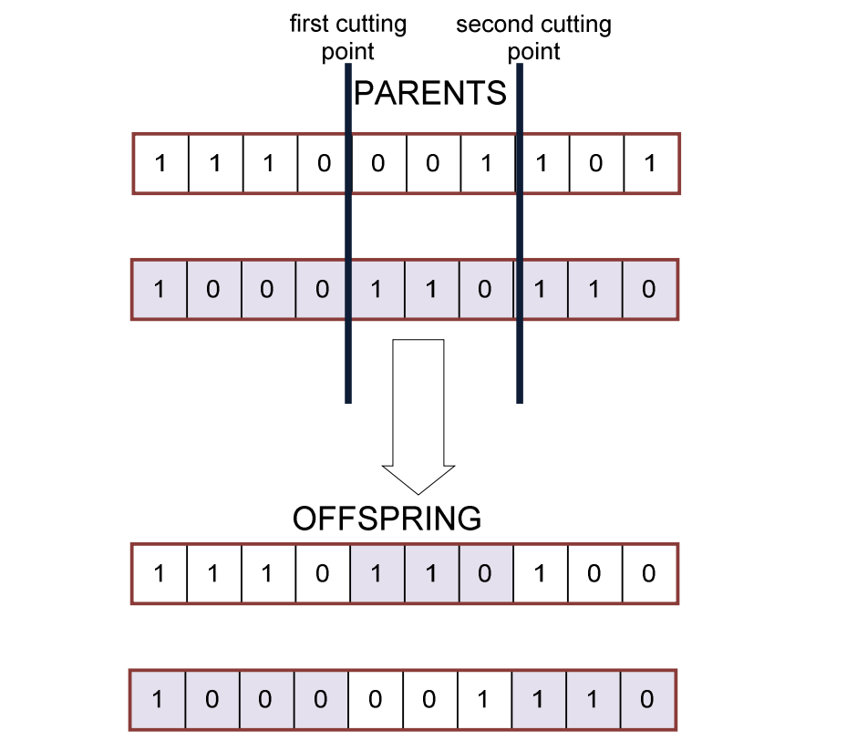
2-Double point crossover

Slide 20
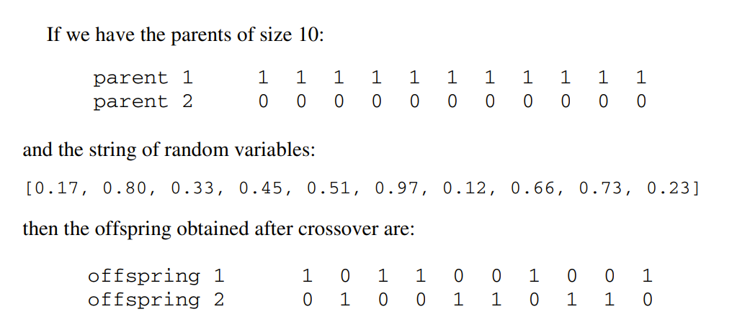
3-Uniform crossover
Uniform crossover works by treating each gene independently and making a random choice as to which parent it should be inherited. This is implemented by generating a string of random variables from a uniform distribution over [0, 1] whose size is equal to the size of an individual from the population. In each position, if the value is below a parameter p (usually 0.5), the gene is inherited from the first parent; otherwise from the second. The second off

Slide 21
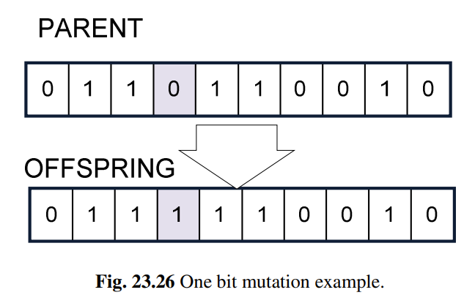
Mutation for Binary Representation
By mutation individuals are randomly altered. These variations (mutation steps) are mostly small. Mutation is only applied to one individual and will produce one offspring. They will be applied to the variables of the individuals with a low probability (mutation probability or mutation rate). Normally, offspring are mutated after being created by recombination
For binary valued individuals' mutation means the flipping of variable values, because every variable has only two states. Thus, the size of the mutation step is always 1.

Slide 22
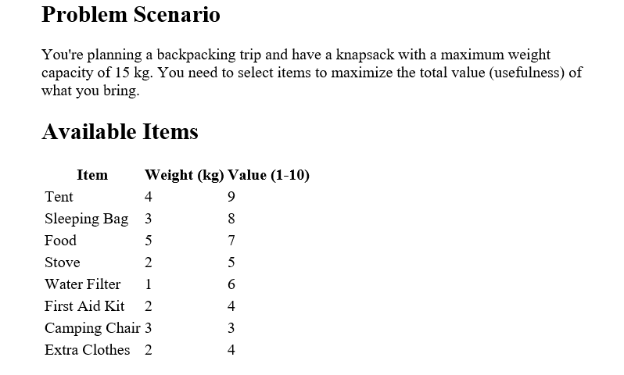
[1, 0, 1, 1, 0, 1, 0, 0] means:
- Tent: Yes (1)
- Sleeping Bag: No (0)
- Food: Yes (1)
- Stove: Yes (1)
- Water Filter: No (0)
- First Aid Kit: Yes (1)
- Camping Chair: No (0)
- Extra Clothes: No (0)
Total weight = 4 + 5 + 2 + 2 = 13 kg (within limit ✓)
Total value = 9 + 7 + 5 + 4 = 25

Slide 23
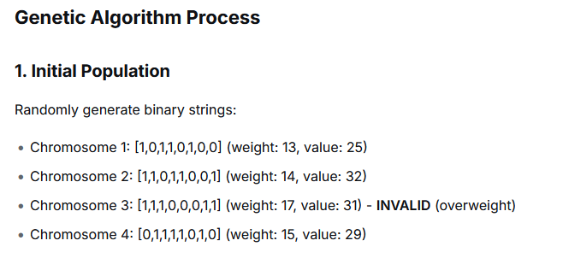
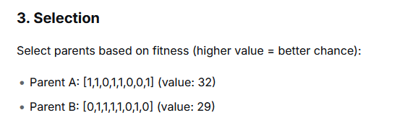

Slide 24
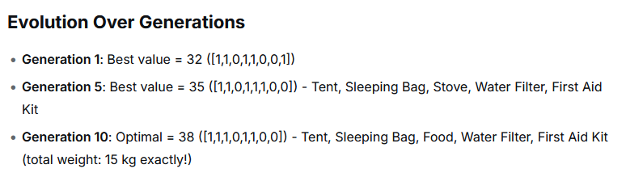
4. Crossover (at point 4)
Parent A: [1,1,0,1 | 1,0,0,1]
Parent B: [0,1,1,1 | 1,0,1,0]
Child: [1,1,0,1 | 1,0,1,0]
5. Mutation (flip random bits)
Child before: [1,1,0,1,1,0,1,0]
Child after: [1,1,0,1,1,1,1,0] (bit 6 flipped from 0→1)

Slide 25
Problem Scenario
Problem: Find x that maximizes f(x) = x², where 0 ≤ x ≤ 31

Slide 26
Since x² is a simple quadratic function, we know the maximum is at x = 31 (f(31) = 961). Let's see how a Genetic Algorithm finds this!
Step 1: Problem Encoding
Binary Representation
Use 5 bits (2⁵ = 32 possible values)
Binary → Integer mapping:
00000 = 0
00001 = 1
00010 = 2
...
11111 = 31
Individual: [1,0,1,1,0] = 22 decimal
f(22) = 484

Slide 27
Step 2: Create Initial Population (Random)
Individual 0: [1,0,1,1,0] = 22 → f(22) = 484
Individual 1: [0,1,0,1,1] = 11 → f(11) = 121
Individual 2: [1,1,1,0,1] = 29 → f(29) = 841
Individual 3: [0,0,1,1,0] = 6 → f(6) = 36
Individual 4: [1,0,0,1,1] = 19 → f(19) = 361
Individual 5: [0,1,1,0,1] = 13 → f(13) = 169
Individual 6: [1,1,0,1,0] = 26 → f(26) = 676
Individual 7: [0,0,0,1,1] = 3 → f(3) = 9
Individual 8: [1,0,1,0,1] = 21 → f(21) = 441
Individual 9: [0,1,1,1,0] = 14 → f(14) = 196

Slide 28
Step 3: Selection (Tournament Size = 3)
Randomly pick 3 individuals, select the best:
Tournament 1: Pick Ind2(841), Ind5(169), Ind9(196) → Winner: Ind2 (841)
Tournament 2: Pick Ind0(484), Ind6(676), Ind3(36) → Winner: Ind6 (676)
Tournament 3: Pick Ind4(361), Ind1(121), Ind8(441) → Winner: Ind8 (441)
Step 4: Take two winners and perform crossover:
Parents:
Parent A (Ind2): [1,1,1,0,1] = 29 (f=841)
Parent B (Ind6): [1,1,0,1,0] = 26 (f=676)
Crossover at point 3:
Parent A: [1,1,1 | 0,1]
Parent B: [1,1,0 | 1,0]
Child 1: [1,1,1 | 1,0] = [1,1,1,1,0] = 30 → f(30) = 900
Child 2: [1,1,0 | 0,1] = [1,1,0,0,1] = 25 → f(25) = 625

Slide 29
Key Insights
Convergence Speed: Simple problem converges in 1-2 generations
Elitism: Preserves best solution found
Mutation: Provides final push from 30→31
Population Diversity: Maintained through crossover

Slide 30
Problem Scenario
A small factory can produce 5 different products. Each product requires specific machine time and generates profit. The factory operates 40 hours per week, and you need to select which products to produce to maximize weekly profit.
Production Data
Product | Machine Hours per Unit | Profit per Unit ($) | Market Demand (max units)
A | 2 | 100 | 10
B | 3 | 150 | 8
C | 1 | 75 | 15
D | 4 | 200 | 5
E | 2.5 | 120 | 12

Slide 31
we need to represent how many units of each product
Encoding Scheme
Each product's quantity is represented by a binary number using enough bits to cover its maximum demand:
Product A (max 10): needs 4 bits (0-15)
Product B (max 8): needs 4 bits (0-15)
Product C (max 15): needs 4 bits (0-15)
Product D (max 5): needs 3 bits (0-7)
Product E (max 12): needs 4 bits (0-15)
Total chromosome length: 4 + 4 + 4 + 3 + 4 = 19 bits

Slide 32
Example Chromosome
Bits: [1010, 0110, 1111, 101, 1001]
Decoded:
- A: 1010₂ = 10 units
- B: 0110₂ = 6 units
- C: 1111₂ = 15 units
- D: 101₂ = 5 units
- E: 1001₂ = 9 units
Total hours = (10×2) + (6×3) + (15×1) + (5×4) + (9×2.5)
= 20 + 18 + 15 + 20 + 22.5 = 95.5 hours (EXCEEDS 40!)

Slide 33
2. Initial Population
Randomly generate 19-bit strings and decode:
Chromosome 1: [0100,0011,1010,010,0110] → Units: 4,3,10,2,6
Hours: 8+9+10+8+15 = 50h (invalid)
Profit: $400+450+750+400+720 = $2720 - penalty = $1720
Chromosome 2: [0011,0010,0101,001,0011] → Units: 3,2,5,1,3
Hours: 6+6+5+4+7.5 = 28.5h (valid)
Profit: $300+300+375+200+360 = $1535
Chromosome 3: [0101,0100,0111,011,0100] → Units: 5,4,7,3,4
Hours: 10+12+7+12+10 = 51h (invalid)
Profit: $500+600+525+600+480 = $2705 - penalty = $1605
Chromosome 4: [0010,0001,1000,010,1010] → Units: 2,1,8,2,10
Hours: 4+3+8+8+25 = 48h (invalid)
Profit: $200+150+600+400+1200 = $2550 - penalty = $1750

Slide 34
جزاكم الله خيرا
وصل اللهم على سيدنا محمد وعلى اله وصحبه وسلم

